Slide 1
“Actionable Gamification”
Presented by Veerendranadh Koppula

Slide 2
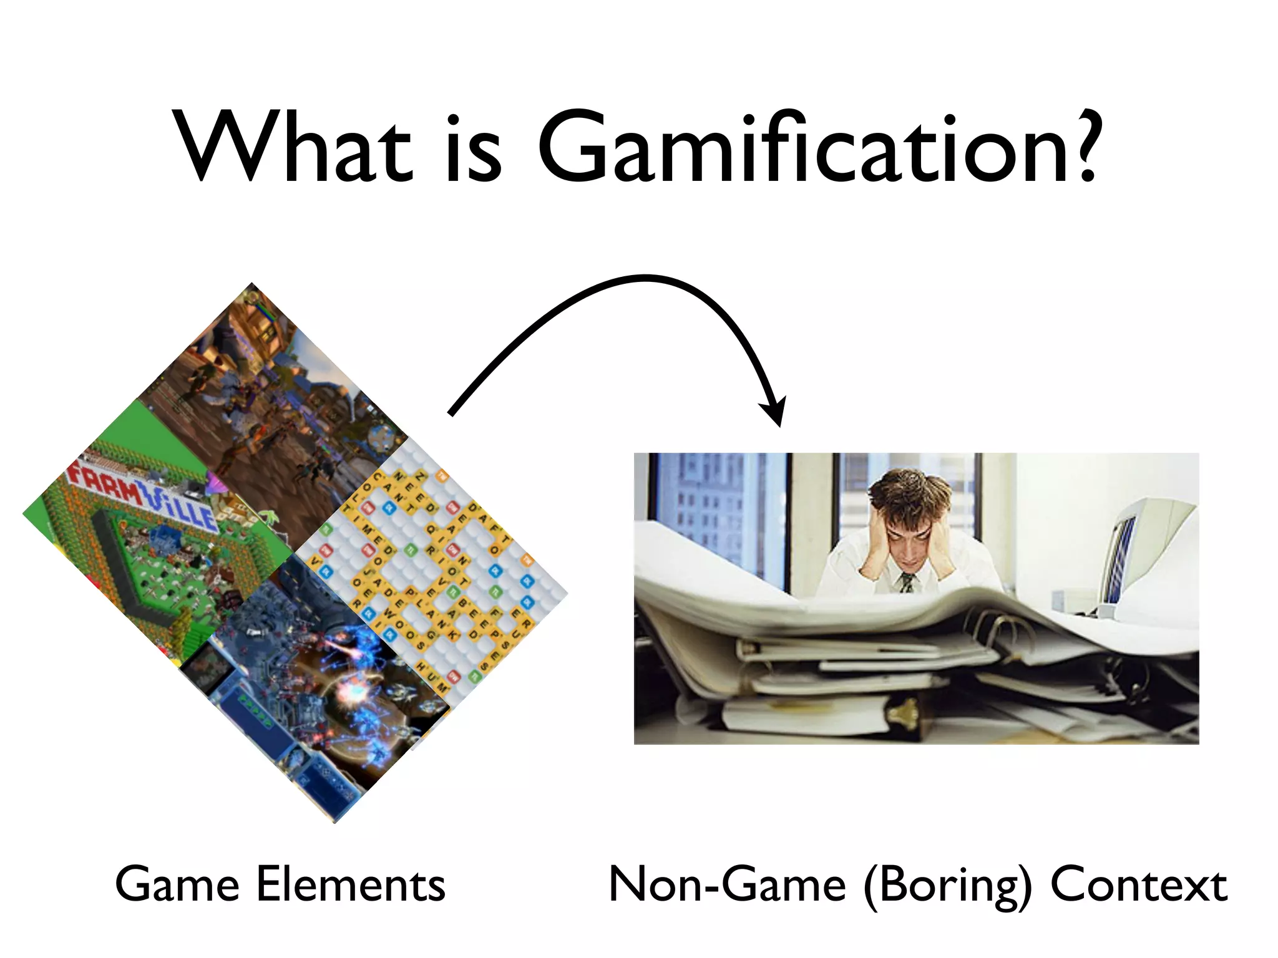
"Turning boring tasks into fun, engaging experiences by using game techniques."

Slide 3
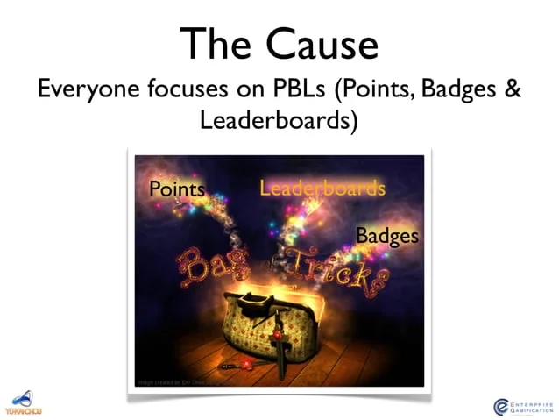
"PBL is like sugar coating , it looks fun but doesn’t build lasting habits."

Slide 4
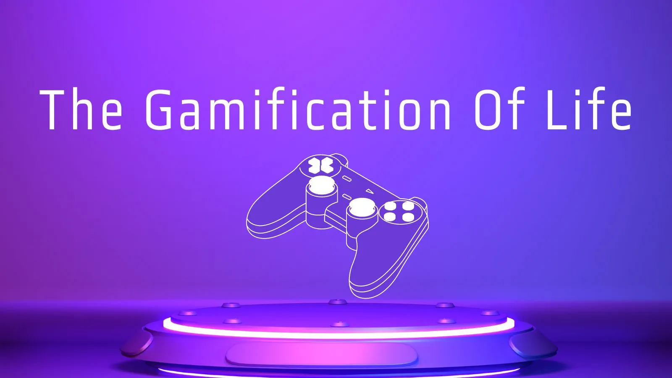
Chapter 1: When the Surreal Blends into our World
Life can feel empty without motivation and purpose.
Games keep us engaged by giving us clear goals and feedback.
Real life can be gamified to feel more meaningful and exciting.

Slide 5
Chapter 2: The PBL Fallacy
Points, Badges, and Leaderboards alone do not create deep motivation.
Gamification must focus on human emotions and engagement.
Surface-level rewards are not enough for lasting behavior change.

Slide 6

Chapter 3: The Octalysis Framework
Human motivation is driven by 8 Core Drives.
A complete experience needs a mix of all drives.
The framework helps design meaningful and fun systems.

Slide 7

Chapter 4: Putting Gamification in its Place
Gamification works only when used in the right context.
It should support a purpose, not distract from it.
Real value should come before gamified layers.

Slide 8
Chapter 5: Epic Meaning & Calling (Core Drive 1)
People are driven by a sense of purpose or mission.
Feeling part of something bigger increases motivation.
This drive works well in early engagement.

Slide 9
Chapter 6: Development & Accomplishment (Core Drive 2)
Progress and achievement are powerful motivators.
Clear goals and feedback improve focus.
Users feel pride in completing challenges.

Slide 10
Chapter 7: Empowerment of Creativity & Feedback (Core Drive 3)
Freedom to choose and create increases engagement.
Users enjoy solving problems in their own way.
Feedback helps guide and reinforce creative actions.

Slide 11
Chapter 8: Ownership & Possession (Core Drive 4)
People care more about things they own or build.
Customization increases emotional connection.
Progress in building or collecting strengthens motivation.

Slide 12
Chapter 9: Social Influence & Relatedness (Core Drive 5)
Social pressure and support affect our choices.
People are motivated by recognition and connection.
Relationships build trust and increase engagement.

Slide 13
Chapter 10: Scarcity & Impatience (Core Drive 6)
Limited access increases desire.
Waiting creates value and anticipation.
People act faster when something may become unavailable.

Slide 14
Chapter 11: Unpredictability & Curiosity (Core Drive 7)
Uncertainty keeps users interested and engaged.
Curiosity drives exploration and repeat actions.
Random rewards can surprise and delight users.

Slide 15
Chapter 12: Loss & Avoidance (Core Drive 8)
People fear losing progress or benefits.
We often act to avoid pain or failure.
Avoidance can keep users consistent in their actions.

Slide 16
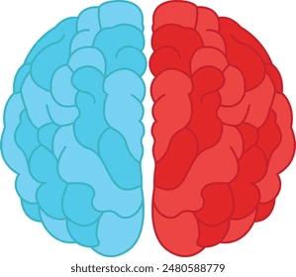
Chapter 13: Left Brain vs Right Brain Core Drives
Left brain drives are logical and result-based.
Right brain drives are emotional and creative.
A good design uses both for balance and impact.

Slide 17

Chapter 14: White Hat vs Black Hat Gamification
White Hat drives feel good but lack urgency.
Black Hat drives create urgency but may feel controlling.
Effective design blends both types at the right time.

Slide 18
Chapter 15: Understanding Other Frameworks with Octalysis
Octalysis builds on other gamification theories.
It includes motivation, psychology, and design.
It provides a clearer structure for real applications.

Slide 19
Chapter 16: Level 1 Octalysis in Action
Real companies use Octalysis successfully.
Different apps use different combinations of drives.
Reviewing examples helps understand practical use.

Slide 20
Chapter 17: Designing a Project from Scratch with Octalysis
Start with user motivation before adding game elements.
Apply different core drives across user journey stages.
Design should evolve through testing and feedback.

Slide 21
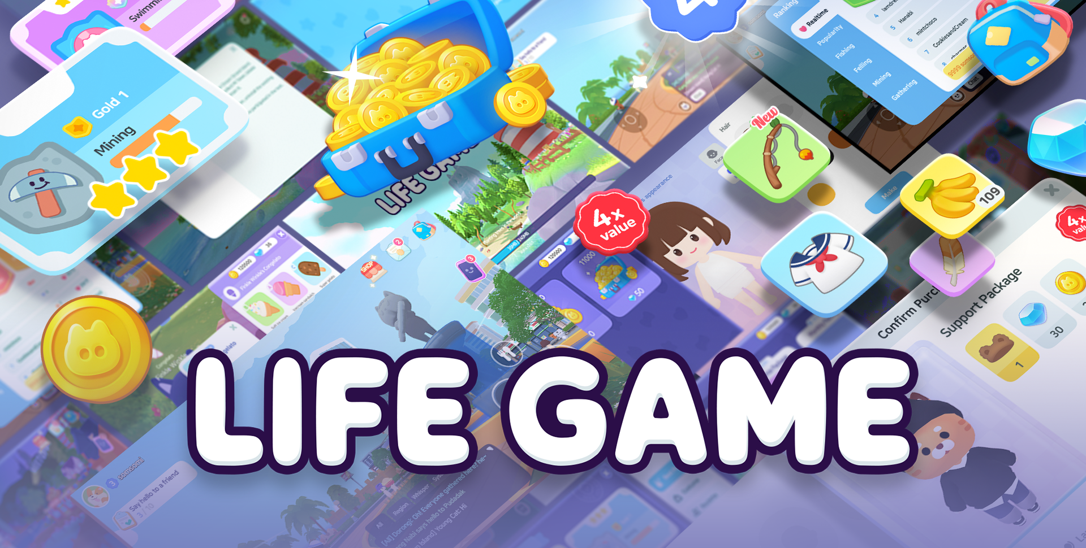
Chapter 18: The Journey Goes On
Gamification is a lifelong mindset.
Keep learning and applying it in new ways.
Make life more meaningful through motivational design.

Slide 22

Thank You!
Presented by:
Veerendranadh Koppula

